Slide 1
Project A
Highly Available, Auto Scaling & Load Balancing Website

Slide 2
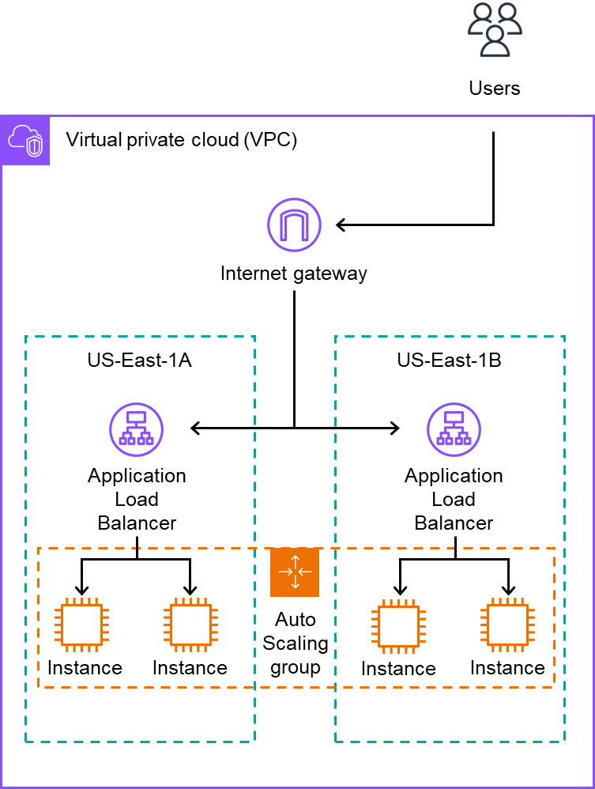
Project A - Overview & Flow
Usage Flow
The instances in the auto scaling group are running the web servers
Users access the website using the generated Load Balancer DNS address
All traffic is evenly distributed by the load balancer across all instances in the auto scaling group
Some Architectural Details
All resources in Virtual Private Cloud (VPC)
2 subnets, each in a different Availability Zone (AZ)
1 Application Load Balancer in each AZ
An Auto Scaling Group spanning 2 AZs
The ASG provisions the EC2 Instances (Web servers)

Slide 3
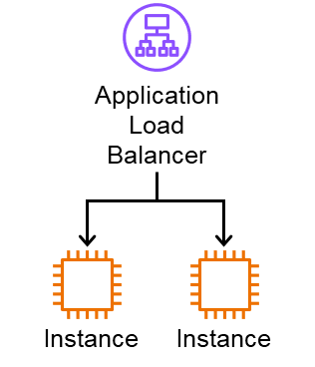
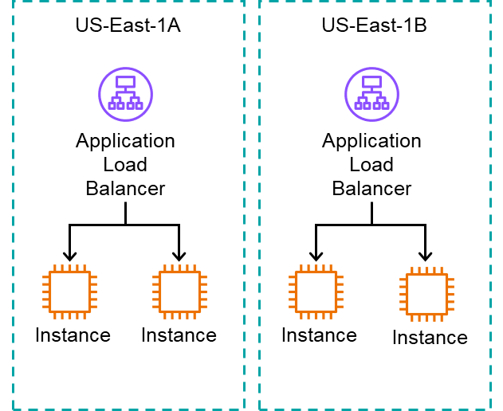
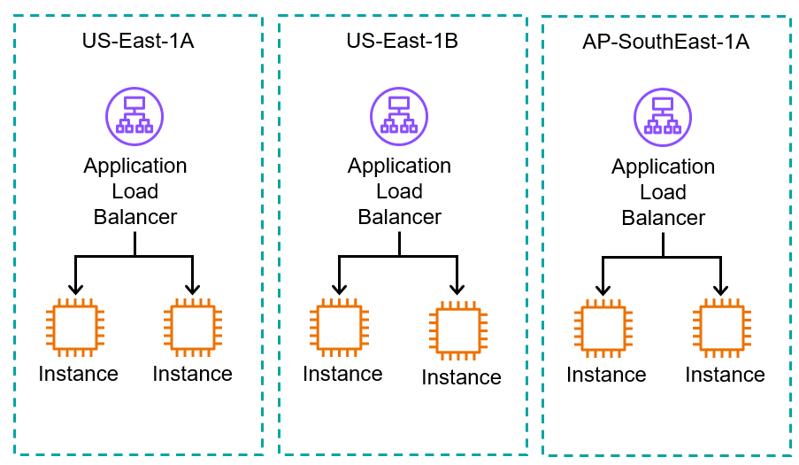
Project A - What is Availability?
Availability refers to a system/applications ability to continuously operate without failing
Therefore, a Highly Available system/application is able to continuously operate without failing even during disruptions (Hardware Failure/Zonal Failure/Region Failure). We can achieve this by distributing our infrastructure across regions/zones.
Hardware Failure
Zonal Failure
Regional Failure

Slide 4
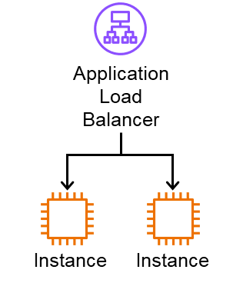
Project A - What is Load Balancing?
Essentially, Load Balancing is the distribution of traffic evenly across downstream resources in a target group
If a 100% of traffic is being forwarded to the Load Balancer, the load balancer will distribute the traffic evenly to the downstream instances (50/50)
100%
50%
50%

Slide 5
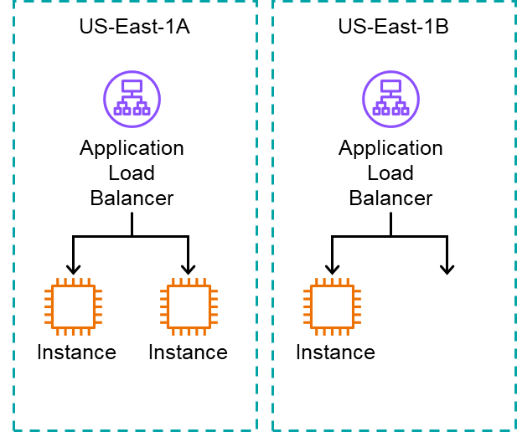
Project A - Cross Zone Load Balancing (CZLB)
CZLB is enabled by default on the ALBs
Q: How does Load Balancing across Availability Zones work?
A: Cross Zone Load Balancing dictates this
Without Cross Zone Load Balancing
Cross Zone Load Balancing
50%
50%
25%
25%
50%
33%
33%
33%

Slide 6


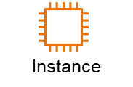
Project A - What is Scalability?
Scalability refers to a system/applications ability to adapt to changes in traffic
There are 2 forms of scalability
Vertical Scalability
Scaling up refers to increasing the specs of current hardware to adapt to greater traffic
Vice versa, scaling down is the downgrading of current hardware to adapt to less traffic
Horizontal Scalability
Scaling out refers to increasing the number of hardware to adapt to greater traffic
Vice versa, scaling in is the decrease in the number of hardware to adapt to less traffic
Scaling Up
Scaling Out
Scaling Down
Scaling In

Slide 7
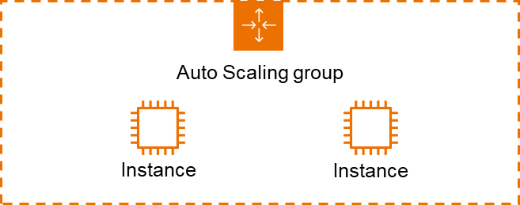
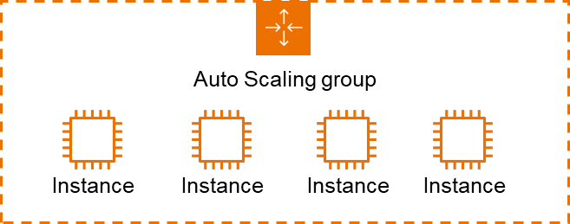
Project A - What is Auto Scaling?
Normal Scaling → Manually upgrading or Manually increasing the instances
Auto Scaling → Auto upgrades and Auto increases the instances
For this workshop, we have an Auto Scaling Group (ASG) which help to manage horizontal scaling automatically
Scaling Out
Scaling In

Slide 8
Project A - Basic Setup
Under the Providers.tf file
Enter in your Access Key & Secret Key of the terraform-user you have made during the startup guide
From Command Prompt, navigate to your project_a folder
TIP: Use the “cd” command to navigate to the folder
Once you have navigated, perform the command “terraform init”

Slide 9
Project A - AWS Provider & terraform init
AWS Provider
Depending on what kind of infrastructure we want to provision with Terraform, we have to use the appropriate provider
For this workshop, we will be using the AWS provider
Essentially, the provider takes the credentials we feed it and use them to create infrastructure
What we can provision depends on the permissions granted to the user where the credentials came from
Terraform Init
The command “terraform init” MUST be called before a Terraform project is usable
It downloads the dependencies needed for Terraform and the provider specified (AWS)

Slide 10

Project A - Virtual Private Cloud (VPC) (environment.tf)
Terraform name: aws_vpc.workshop-vpc
A VPC is an isolated virtual network defined within the public cloud. This will allow us to setup a private cloud environment for our resources
TLDR: This serves as a private container to provision our resources inside
For the workshop, I have provisioned the CIDR block of 10.0.0.0/16 (10.0.0.0 to 10.0.255.255) which is 65.536 addresses

Slide 11

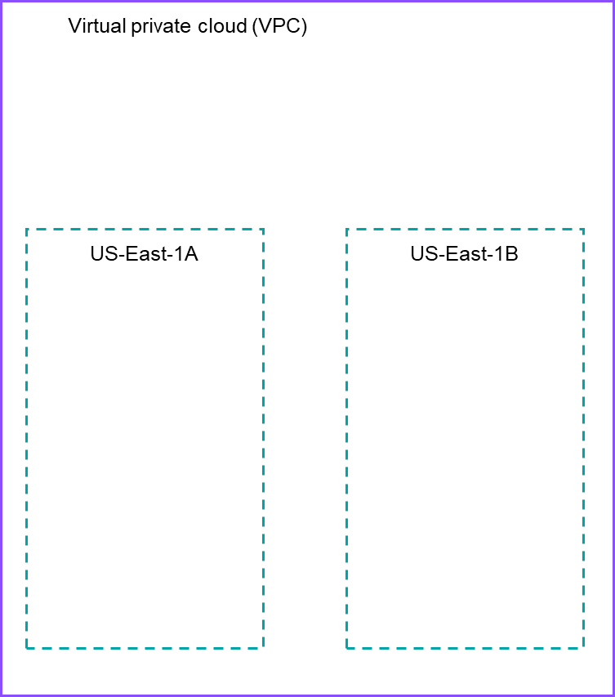
Project A - Subnets (environment.tf)
Terraform names:
aws_subnet.east-1a-subnet, aws_subnet.east-1b-subnet
TLDR: Subnets are partitions of a VPC
I have defined one subnet in the zone of east-1a and one subnet in the zone of east-1b
The east-1a subnet has a CIDR block of 10.0.1.0/24 and east-1b subnet has a CIDR block of 10.0.2.0/24 (251 addresses free for each subnet)
By hosting our website across 2 AZ, we are ensuring high availability of our web app

Slide 12
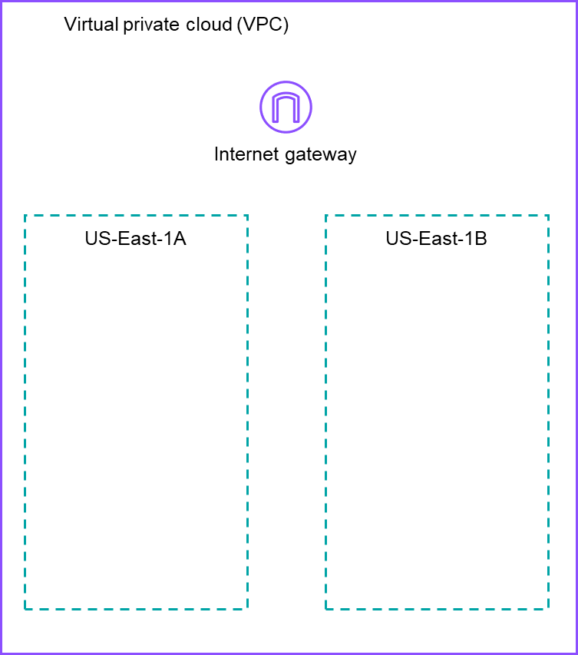
Project A - Internet Gateway (environment.tf)
Terraform name: aws_internet_gateway.internet-gateway
Right now, our subnets have no internet access (private subnets), but we need our users to access the website from the infrastructure inside
Therefore, we can an internet gateway to establish internet access to the resources within the subnets (private subnet -> public subnet)

Slide 13
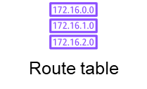
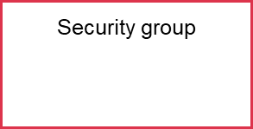
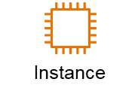
Project A - Route Table & Security Group (environment.tf)
Route Table
Security Group
Terraform names: aws_route_table.route_table,
aws_route_table_association.rt1, aws_route_table_association.rt2
TLDR: It is attached to subnets to help guide outbound traffic meant for the internet to the internet gateway to exit the VPC
Terraform name: aws_security_group.workshop_sg
TLDR: It acts as a virtual firewall for individual EC2 instances/virtual servers. Restricts the inbound and outbound traffic of the associated instances
For the workshop, I have basically allowed all HTTP, HTTPS and SSH inbound traffic and allowed all outbound traffic for convenience

Slide 14
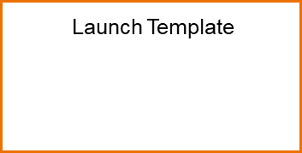




Project A - Launch Template (project.tf)
Terraform name: aws_launch_template.template
TLDR: Literally defines a template which can be used to create instances abiding by the specification inside
AMI (Amazon Machine Image): We want to run an Amazon Linux 2 instance
Userdata: We want to run a shell script upon instance creation (runs once only) to setup the web server
Instance: We want the hardware specs to be t2.micro (1 CPU core, 1 GiB of RAM)
Security Group: Attach previous SG to all instances created with this template
AMI
Userdata
Instance Type
Security Group

Slide 15
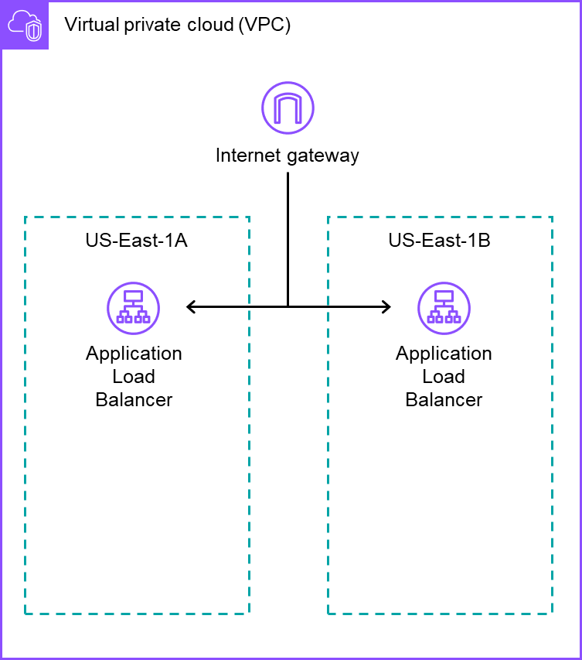
Project A - Application Load Balancers (project.tf)
Terraform name: aws_lb.load_balancer
We are now creating a load balancer for each subnet
The load balancer type we are using is called the Application Load Balancer
Cross Zone Load Balancing is on by default for ALB, so expect all traffic to be distributed evenly across all targets in a target group regardless of AZ

Slide 16
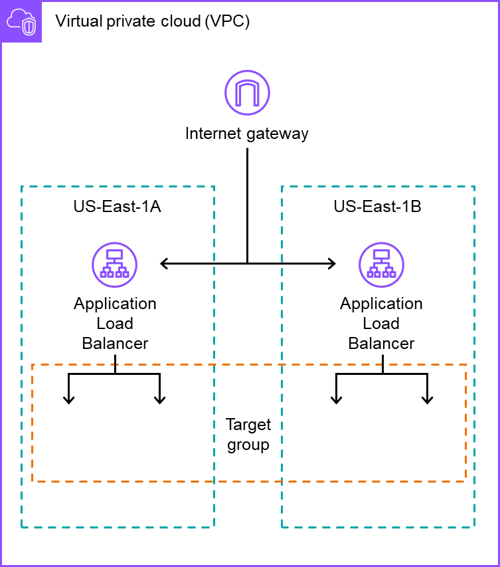
Project A - Target Group & Listener (project.tf)
Terraform names:
aws_lb_target_group.target_group,
aws_lb_listener.listener
Firstly, we create an EMPTY target group for our load balancers to target
Secondly, we create a listener, which will forward all incoming traffic to our load balancer to our target group (This is what connects our load balancer and target group together)

Slide 17
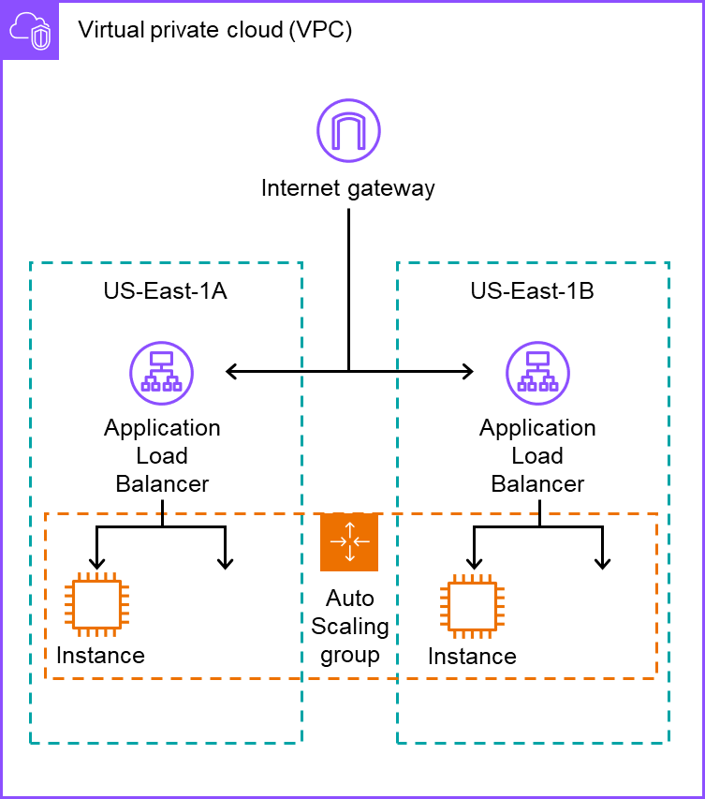
Project A - Auto Scaling Group (ASG) (project.tf)
Terraform name: aws_autoscaling_group.auto_scaling_group
IMPORTANT: Please note that we are not turning our target group into an Auto Scaling Group (ASG). We are instead putting our auto scaling group INSIDE of the target group to act as a target
Details of the ASG:
Spans across the 2 AZs, represented by our subnets
Has a desired capacity of 2 (Provision 2 instances at the ASG’s creation)
Has a minimum capacity of 2 (Cannot drop below 2 instances)
Has a maximum capacity of 4 (Cannot exceed above 4 instances)
Instances made in the ASG will be according to the Launch Template made earlier

Slide 18
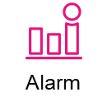

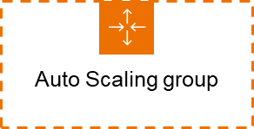
Project A - Scaling Policy & CloudWatch Alarms (project.tf)
Terraform name:
aws_autoscaling_policy.scale_out_policy,
aws_cloudwatch_metric_alarm.scale_out_alarm,
aws_autoscaling_policy.scale_in_policy,
aws_cloudwatch_metric_alarm.scale_in_alarm
Although we have defined the min & max ranges of the ASG, we still have no way of scaling according to traffic demands
Therefore we can define a scaling policy and an alarm to trigger a scaling event
Scale out alarm: Will trigger the scale out policy when average CPU usage equals or exceeds 40%, evaluated in 2 minute time frames. The policy starts a scale out event which increases the instance count by 1
Scale in alarm: Will trigger the scale in policy when average CPU usage equals or is below 20%, evaluated in 2 minute time frames. The policy starts a scale in event which decreases the instance count by 1
Scaling Policy

Slide 19
Project A - Project Creation & Live Demo
Creating the project
Ensure that your Command Prompt is navigated to your “project_a” folder
Perform the command “terraform apply”
Terraform will return you the infrastructure plan that it is about to provision
It will then prompt you to input either “yes” or “no” to confirm the provisioning of infrastructure
Input “yes” and sit back and relax (For faster computers: ETA 2mins, expect longer wait times on a slower device)
Live Demo
I will demo the load balancing and auto-scaling on screen

Slide 20
Project A - Project Destruction
Destruction of Project
Ensure that your Command Prompt is navigated to your “project_a” folder
Perform the command “terraform destroy”
Terraform will return you the infrastructure plan that details the destruction
It will then prompt you to input either “yes” or “no” to confirm the destruction of infrastructure
Input “yes” and sit back and relax (Same ETA as “terraform apply”)

Slide 21
Project B
Storage Notification Email System with Message Queue Decoupling

Slide 22
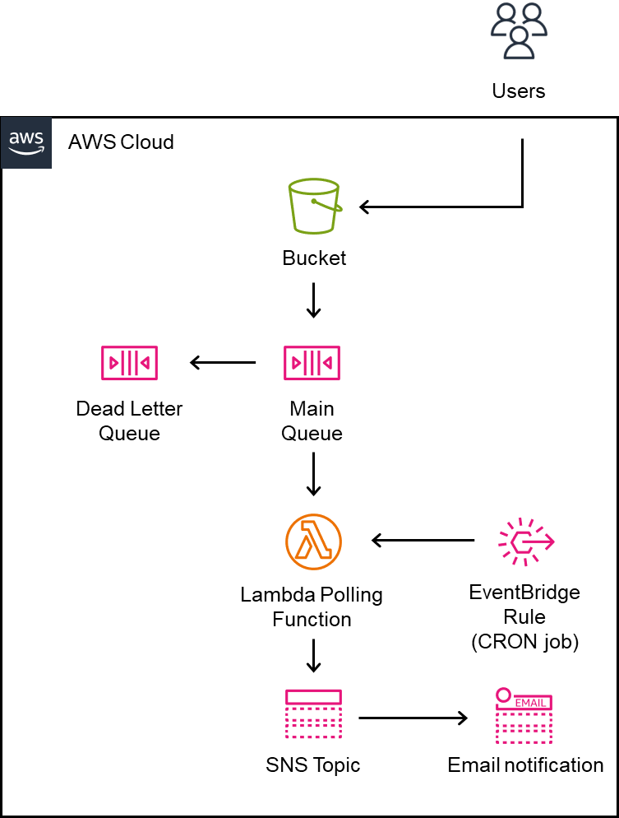
Project B - Overview & Flow
Usage Flow
The bucket notification sends a message to the SQS main queue upon text file creation and deletion within the S3 bucket
A lambda polling function will be run every minute to receive the messages in the queue
Creation-event messages will be processed, triggering a message to be sent to an SNS topic, delivering an email to all subscribers of the topic
Deletion-event messages will fail processing and eventually end up in the Dead Letter Queue
Some Architectural Details
1 S3 bucket, 1 main and 1 dead letter queue
1 Lambda function, 1 EventBridge rule, 1 SNS Topic and 1 subscription

Slide 23
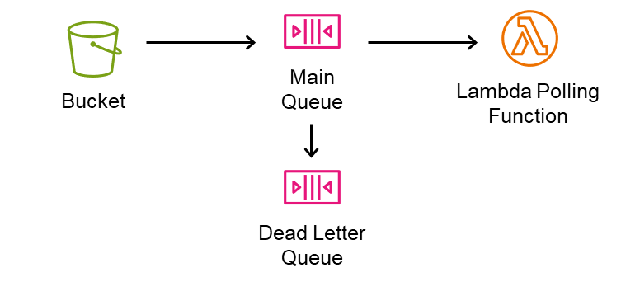
Project B - Message Queues
Sending
Polling
Failed
Producer
Consumer
Step By Step
Producers sends messages to the queue
Consumers poll messages from the queue (Getting the message information to process, not deleting the messages from the queue).
Once a message is polled, it becomes invisible to other consumers in the queue for a specific period, known as the visibility timeout
After a consumer successfully processes a message, it will delete the message from the queue
If the consumer does not delete the message within the visibility timeout period (either visibility timeout is too short or message has failed to be processed), the message becomes visible again in the queue and can be processed by another consumer
If a Dead Letter Queue is setup, message that have failed processing a set number of times will be sent to the DLQ for the purpose of debugging why they are failing

Slide 24
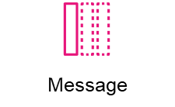
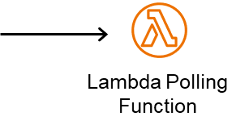

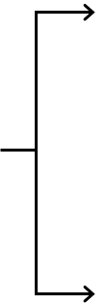





Project B - Message Polling Visualised
Processing Failed (Invisibility runs out as message is not deleted), gets processed by another consumer
Polling (Getting Msg Info)
Processing Msg Info
Processing too long (Invisibility runs out), gets processed twice
Finished Processing, Deleting actual message

Slide 25
Project B - Benefits of Message Queues
Decoupling
By putting a medium between the producer and consumer, we can ensure that the consumer does not get overwhelmed/throttled as we can adjust the polling rate
As queues fulfill asynchronous requests (sent first, settle later), the producers can just send a message and move on to other tasks (doesn’t have to wait for a response)
Producer and consumer do not have to directly interact, makes replacing either of them easier
Persistence
Requests will not be lost during service failures. Throttling is also prevented so messages will not be lost under high application stress
All messages in a queue are processed at least once. The only way to leave is getting polled.

Slide 26
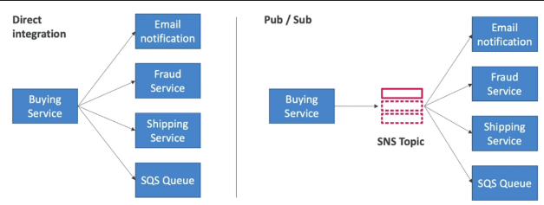
Project B - Publish-Subscribe (Pub/Sub) Messaging
Step by Step
First, a topic is made. Think of a topic as a “channel” or “subject” where messages are sent
Subscribers need to subscribe to a topic they are interested in
Publishers will send messages to a topic
The message sent to the topic will then be sent to all active subscribers

Slide 27
Project B - Benefits of Pub/Sub
Decoupling
Same as SQS, except it does not prevent message loss during throttling
Broadcasting
Enables the delivery of the same message to the subscribers of the chosen topic. Therefore the same message can be processed by different subscribers in different ways.
Time Critical
Although both message queues and pub/sub are considered asynchronous (send first, settle later), pub message are immediately pushed out to active subs once they arrive whereas the processing time of messages in queues are determined by the polling consumer
Persistence
Not a benefit, SNS lacks persistence. So if messages are sent to inactive subscribers, they will be lost. If a subscriber becomes inactive during the sending, the message will also be lost.

Slide 28
Project B - Basic Setup
Under the “providers.tf” file
Enter in your Access Key & Secret Key of the terraform-user you have made
Under the “terraform.tfvars”
Enter your school email address under the specified variable
Enter your AWS account number (Click the top right hand of the AWS Console homepage) under the specified variable
NOTE: Ensure both variables are strings/inside quotation marks
From Command Prompt, navigate to your project_b folder
TIP: Use the “cd” command to navigate to the folder
Once you have navigated, perform the command “terraform init”

Slide 29
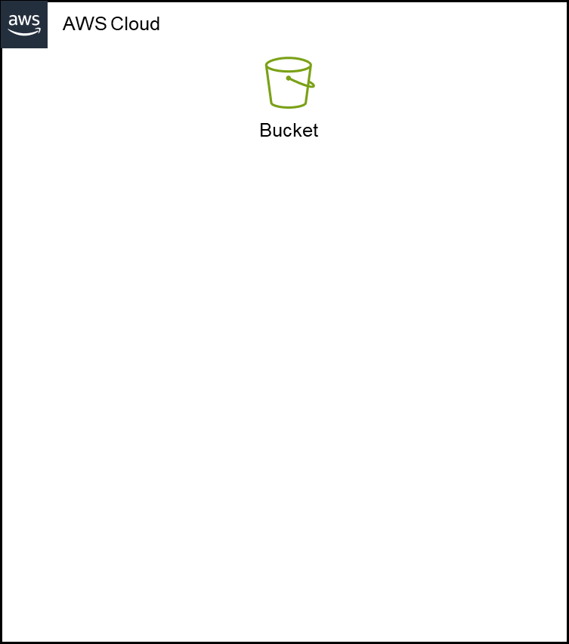
Project B - S3 Bucket (project.tf)
Terraform name: aws_s3_bucket.bucket
To perform the activities of text file creation and deletion, I have created an S3 bucket to help store the files
As bucket names must be universally unique, I have used a random string generator to help create a new random name everytime a new bucket is provisioned to prevent errors during the workshop

Slide 30
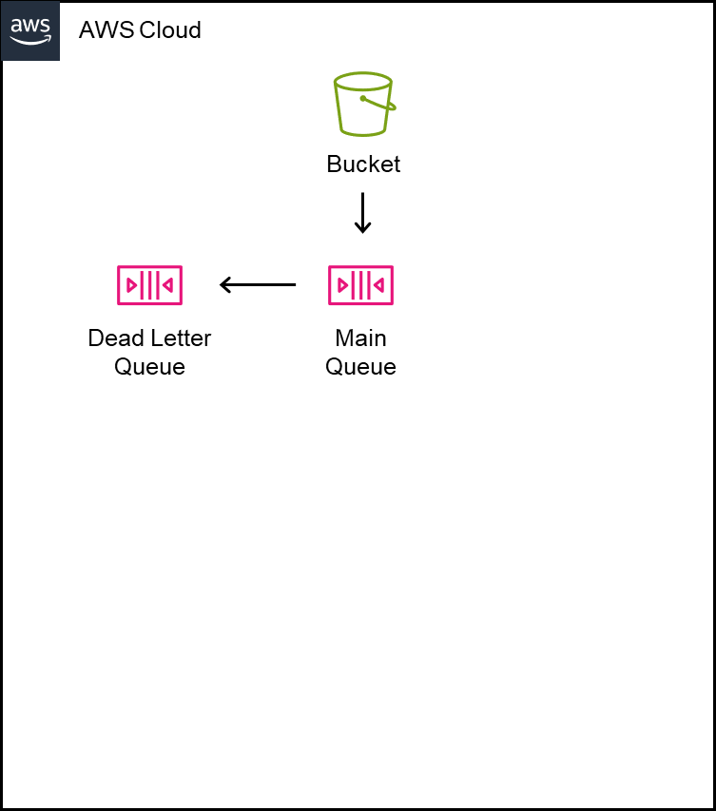
Project B - Main Queue & Dead Letter Queue (project.tf)
Terraform name:
aws_sqs_queue.queue, aws_sqs.dead_letter_queue
The main queue and DLQ will have a message retention of 80K seconds (Do not need to care) and a visibility timeout of 30 seconds
The “redrive policy” on the main queue helps to specify that the DLQ we made will be associated with the main one.
The maximum number of times a message can be polled before being shifted to the DLQ has been set to 2

Slide 31
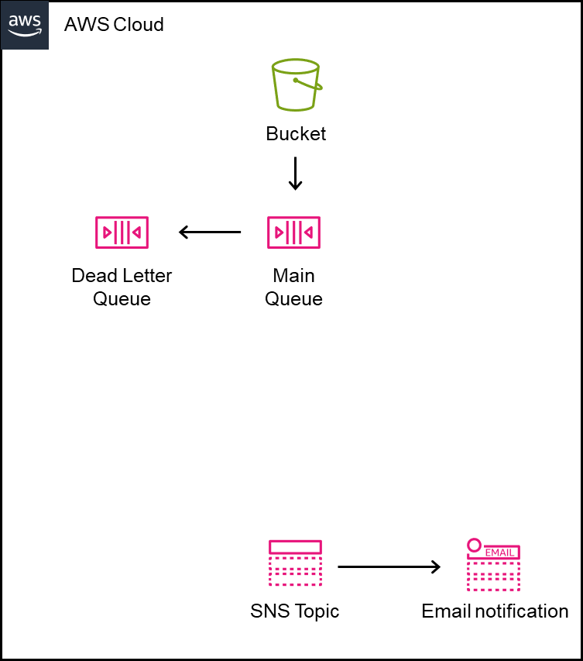
Project B - Bucket Notif & SNS Topic + Sub (project.tf)
Terraform name:
aws_s3_bucket_notification.bucket_notification,
aws_sns_topic.topic,
aws_sns_topic_subscription
Here we are creating a bucket notification which will send a message to the main queue upon the creation or deletion of a text file
.txt file created -> send message to queue detailing event
.txt file deleted -> send message to queue detailing event
After this, we can create a topic called “topic” and add our school email as an email subscriber (make sure to check your outlook emails later)
Messages sent to the topic will be sent to the specified school email in the form of an email

Slide 32
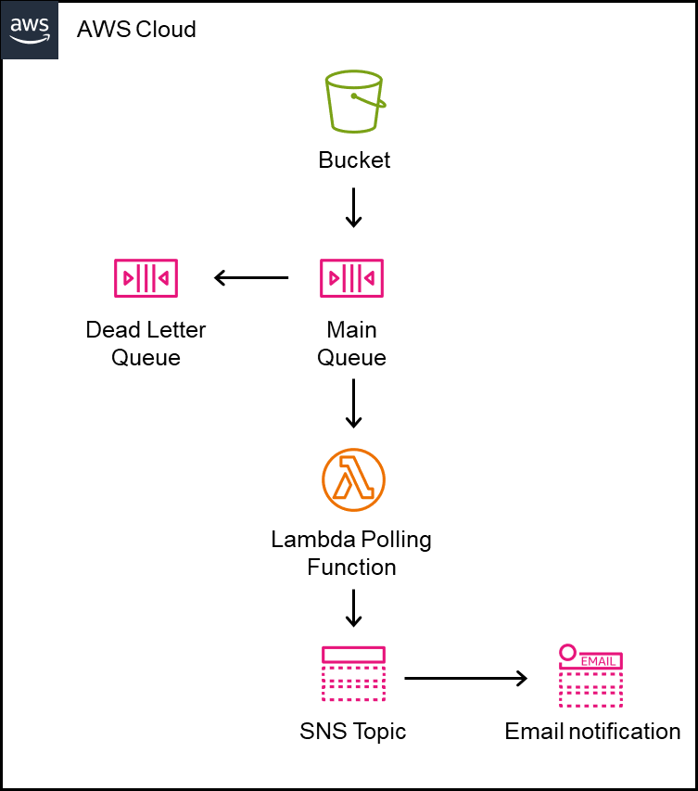
Project B - Lambda Polling Function (project.tf)
Terraform name:
aws_lambda_function.polling_function
TLDR: A lambda functions is a miniature server where I can run individual scripts of code without having to manage any underlying infrastructure
I have defined a lambda function to act as our polling consumer.
It has the following behaviors
When ran, this lambda function will poll messages from the queue and selectively process them
Messages concerning the creation of a new text file will cause the lambda to send a message to the SNS topic
Messages concerning the deletion of a text file will not be processed ON PURPOSE, to show the capabilities of the dead letter queue

Slide 33
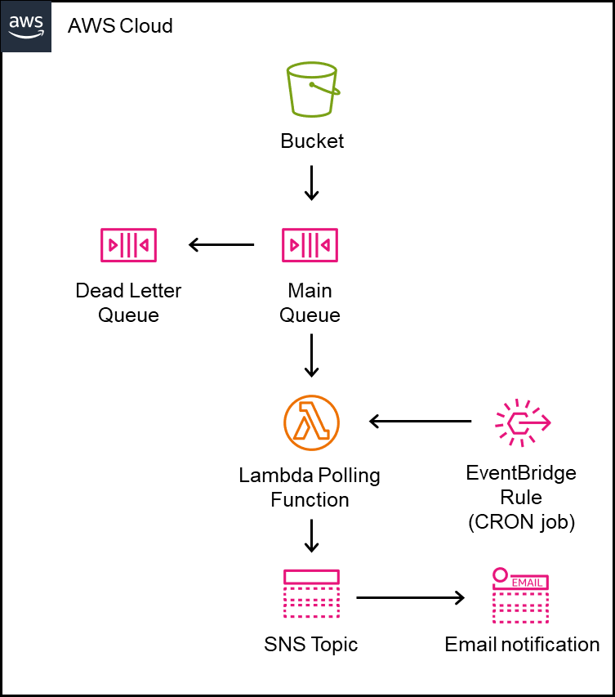
Project B - EventBridge Rule (project.tf)
Terraform name:
aws_cloudwatch_event_rule.lambda_cron_rule,
aws_cloudwatch_event_target.lambda_cron_target
TLDR: A CRON job refers to a command that runs automatically according to a scheduled time frame
To poll the queue under a scheduled time, I defined a CRON job using an EventBridge CRON rule and designated the lambda polling function as the target
The CRON rule will run the lambda polling function once every 1 minute to fulfill the messages in the queue

Slide 34
Project B - Project Creation & Live Demo
Creating the project
Ensure that your Command Prompt is navigated to your “project_b” folder
Perform the command “terraform apply”
Terraform will return you the infrastructure plan that it is about to provision
It will then prompt you to input either “yes” or “no” to confirm the provisioning of infrastructure
Input “yes” and sit back and relax (For faster computers -> ETA 2mins, expect longer wait times on a slower device)
Live Demo
I will demo the sending, polling and fulfillment of SQS messages

Slide 35
Project B - Project Destruction
Destruction of Project
Ensure that your Command Prompt is navigated to your “project_b” folder
Perform the command “terraform destroy”
Terraform will return you the infrastructure plan that details the destruction
It will then prompt you to input either “yes” or “no” to confirm the destruction of infrastructure
Input “yes” and sit back and relax (Same ETA as “terraform apply”)

Slide 36
Destroying Infra & Closing Acc
Please listen to verbal instructions
Readable guide will be sent after workshop just in case

